Slide 1
Insights from Statistical Physics into Computational Complexity
Bart Selman
Cornell University
Joint with Scott Kirkpatrick (IBM Research)

Slide 2
Computational Challenges
Many core computational tasks have been shown to be computationally intractable.
We have results in:
      reasoning
      planning
      learning

Slide 3
A Few Examples
Reasoning
  many forms of deduction
  abduction / diagnosis (e.g. de Kleer 1989)
  default reasoning (e.g. Kautz and Selman 1989)
  Bayesian inference (e.g. Dagum and Luby 1993)
Planning
  domain-dependent and independent (STRIPS)
  (e.g. Chapman 1987; Gupta and Nau 1991; Bylander 1994)
Learning
  neural net “loading” problem (e.g. Blum and Rivest 1989)

Slide 4
Complexity Results, Cont.
An abundance of negative complexity results.
Results often apply to very restricted formalisms, and also to finding approximate solutions.

Slide 5
What is the practical impact of negative complexity
results for AI?
Does explain part of the difficulty in making
advances in reasoning, planning, and learning
Many tasks appear to require exponentially growing search spaces.
But, how about
worst-case vs. average-case vs. typical case (practice)?

Slide 6
What Is The Impact Of These Results?
Results are based on a worst-case analysis and there continues to be a debate on their practical relevance.
On the one hand, there are successful systems
that do not appear to be hampered by the negative complexity results.
Examples: Bayesian net applications,
Neural nets,
CLASSIC KR system (Brachman et al. 1989)

Slide 7
On the other hand, in other domains, negative complexity properties are a clear obstacle in
scaling-up the systems.
  Examples: ATMS diagnosis: 25+ components
  planning systems: 20+ objects and operators
  (Real domains: 1,000+ elements.)
Contradictory experiences lead to the question:
When and where do computationally
hard instances show up?

Slide 8
A --- A better understanding of the nature of
computationally hard problems.
B --- New stochastic methods for solving such
problems.

Slide 9
Overview
PART A. Computationally Hard Instances
  worst-case vs. average-case
  critically-constrained problems
  phase transitions
PART B. Stochastic Methods
  heuristic repair, GSAT, and simulated annealing
  comparison with systematic methods
  asymmetry consistency / inconsistency
Summary

Slide 10
PART A. Computationally Hard Instances
I’ll use the propositional satisfiability problem (SAT)
to illustrate ideas and concepts throughout this talk.
SAT: prototypical hard combinatorial search and reasoning problem.
Several of these concepts have also been studied in the context of Constraint Satisfaction Problems. In particular, see the work by Cheeseman and colleagues (1991).

Slide 11
Satisfiability
SAT: Given a formula in propositional calculus, is there an assignment to its variables making it true?
We consider clausal form, e.g.:
(a b c) ( b d (b c e) . . .
Problem is NP-Complete. (Cook 1971)
Shows surprising “power” of SAT for encoding computational problems.
2,000+ NP-complete problems identified so far.
)

Slide 12
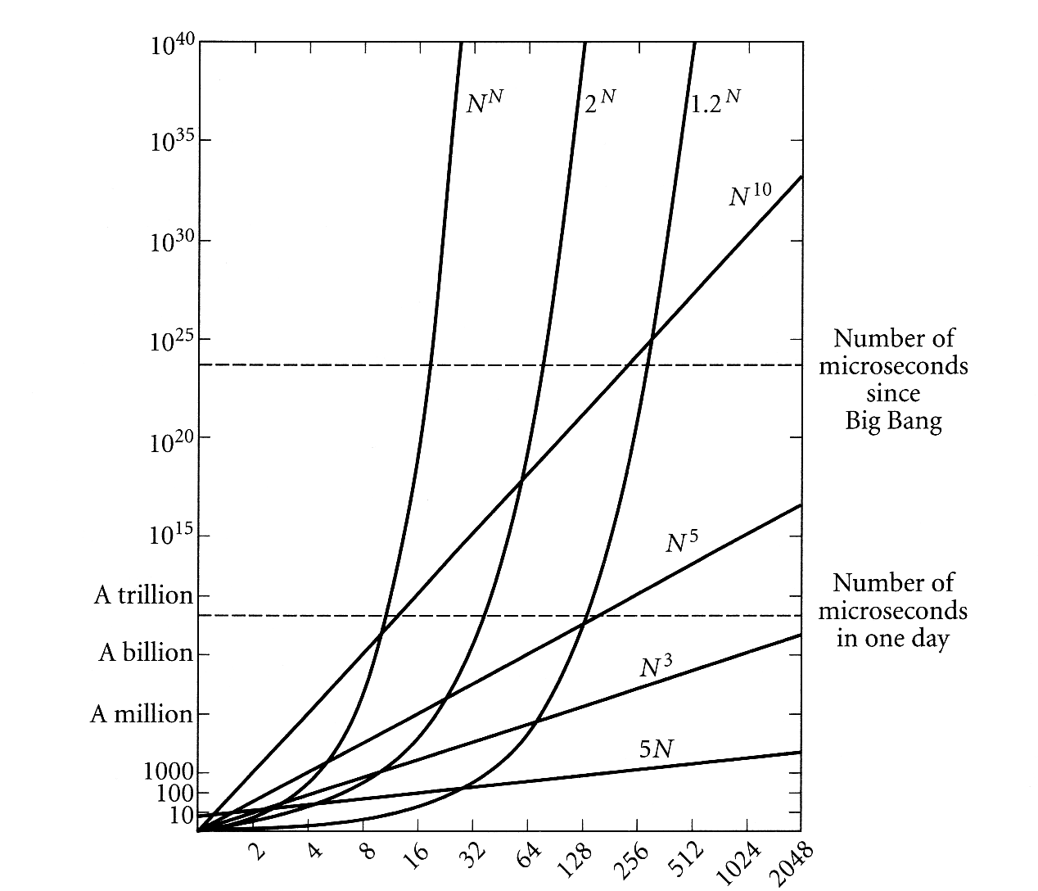
Eg
FOL
Theorem
Proving…
sigh…
exponential
polynomial

Slide 13
SAT: Worst-Case Complexity
SAT is an NP-complete problem
Worst-case believed to be exponential (roughly 2^{N} for N variables)
10,000+ problems in CS are NP-complete -- equally hard and “reducible” to one-another (e.g. planning, scheduling, protein folding, reasoning, traveling salesperson, …)
P vs. NP --- $1M Clay Prize
exponential
polynomial

Slide 14
Computational Complexity Hierarchy
EXP-complete:
games like Go, …
EXP
Hard
PSPACE-complete:
QBF, planning, chess (bounded), …
PSPACE
#P-complete/hard:
#SAT, sampling,
probabilistic inference, …
P^#P
PH
NP-complete:
SAT, propositional
reasoning, scheduling,
graph coloring, puzzles, …
NP
P-complete:
circuit-value, …
P
In P:
sorting, shortest path, …
Easy
Note: widely believed hierarchy; know P≠EXP for sure

Slide 15
Some Example Applications Of SAT
constraint satisfaction
  scheduling and planning
  VLSI design and testing (Larrabee 1992)
direct connection to deductive reasoning
part of many reasoning tasks
  diagnosis / abduction
  default reasoning
Learning / Protein folding / Finding proofs
  Σ α iff Σ { α} is not satisfiable
⊃

Slide 16
How well can SAT be solved in practice?

Slide 17
Average-Case Analysis
Goldberg (1979) reported very good performance of Davis-Putnam (DP) procedure on random instances.
  But distribution favored easy instances. (Franco and Paull 1983)
Problem: Many randomly generated SAT problems are surprisingly easy.
Goldberg used variable-clause-length model:
  For each clause, pick each literal with probability p.

Slide 19
But the problem is NP-complete ...
where are the hard instances?

Slide 20
Generating Hard Random Formulas
Key: Use fixed-clause-length model.
  (Mitchell, Selman, and Levesque 1992)
Critical parameter: ratio of the number of clauses
to the number of variables.
Hardest 3SAT problems at ratio = 4.3

Slide 22
Intuition
At low ratios:
  few clauses (constraints)
  many assignments
  easily found
At high ratios:
  many clauses
  inconsistencies easily detected

Slide 24
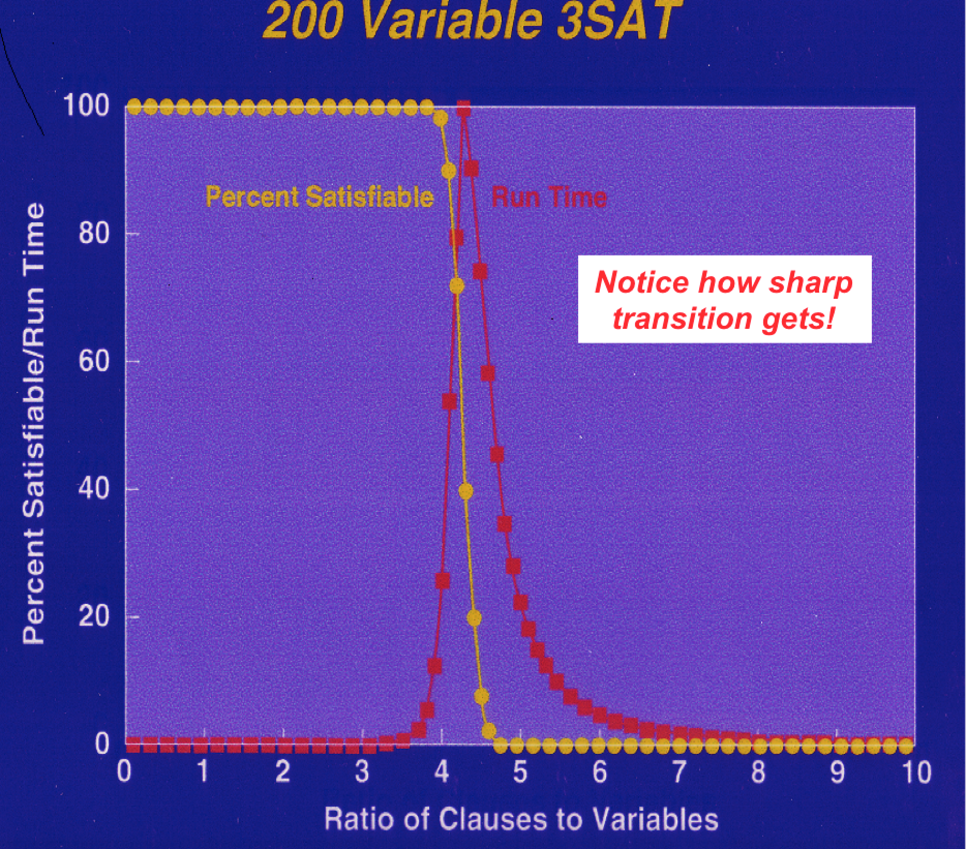
The region of
interest

Slide 25
Theoretical Status Of Threshold
Very challenging problem ...
Current status:
  3SAT threshold lies between 3.003 and 4.8
  (Chayet et al. 1999; Friedgut 1997;
  Motwani et al. 1994; Broder and Suen 1993;
  Broder et al. 1992; Dubois 1990)

Slide 27
Phase Transition Phenomenon
Can be analyzed using finite-size scaling techniques.
(Kirkpatrick and Selman, Science 1994)

Slide 30
Summary Phase Transition Effect
Coincides with hardest instances.
Behavior at threshold can be analyzed with
tools from statistical physics:
  Threshold has universal form with predictable
  corrections for N (number of vars).
  Inverse transformation gives 50% point for testing.
    (Also, rescaling cost function; Selman and Kirkpatrick 1995, Gent and Walsh 1995)

Slide 31
Similar phenomenon for graph coloring.
  random graphs
  3-coloring; threshold around 4.6 (connectivity)
    (Cheeseman et al. 1991)
Critically-constrained --- Practical relevance
  Airline fleet scheduling (Nemhauser 1994)
  VLSI design (Agrawal 1991)
  Traveling Salesperson Problem (Gent and Walsh 1995)
See also Hogg, Huberman, and Williams 1996; Crawford and Auton 1993; Frost and Dechter 1994; Larrabee and Tsuji 1993; Schrag and Crawford 1996; Smith and Grant 1994; Smith and Dyer 1996; and more!

Slide 32
PART B. Fast Stochastic Methods
After having identified hard instances, can we
find better algorithms for solving them?
Answer: Yes (at least for half of them...)

Slide 33
Standard Procedures For SAT
Systematic search for a satisfying assignment.
Interesting situation:
  Davis-Putnam (DP) procedure, proposed in 1960, is still the fastest complete method!
  Backtrack-style procedure with unit propagation.
    SAT Competition 1992; DIMACS Challenge 1993 / 1994

Slide 34
DP provides very challenging benchmark for comparisons with other systematic (complete) procedures.
  Not just on random formulas!
Many other methods have been tried, e.g.,
  1) Backtracking with sophisticated heuristics
    (Purdom 1984; Zabih and McAllester 1988; Andre and Dubois 1993; Bhom 1992; Crawford and Auton 1993; Freeman 1993, etc.)
  2) Translations to integer programming
    (Jeroslow 1986; Hooker 1988; Karmarkar et al. 1992; Gu 1993)

Slide 35
  3) Exploiting hidden structure
    (Stamm 1992; Larrabee 1991; Gallo and Urbani 1989;
    Boros et al. 1993)
  4) Limited resolution at the backtrack nodes
    (Billionet and Sutter 1992; van Gelder and Tsuji 1993)
And others!
Open Question: Why don’t they beat DP?
Let’s try something completely different ...

Slide 36
Randomized Greedy Local Search: GSAT
Begin with a random truth assignment.
Flip the value assigned to the variable that yields
greatest number of satisfied clauses.
Repeat until a model is found, or have performed
specified maximum number of flips.
If model is still not found, repeat entire process,
starting from different random assignment.
  (Selman, Levesque, and Mitchell 1992)

Slide 37
How Well Does It Work?
First intuition: Will get stuck in local minimum,
with a few unsatisfied clauses.
No use for almost satisfying assignments.
E.g., a plan with a “magic” step is useless.
Contrast with optimization problems.
Surprise: It often finds global minimum!
I.e., finds satisfying assignments.
Inspired by local search for CSP initially used on
N-Queens: Heuristic Repair Method. (Minton et al. 1991)

Slide 38
GSAT outperforms Davis-Putnam on, e.g.:
Hard random formulas
  DP: up to 400 vars; GSAT: 2000+ var formulas.
Boolean encodings of graph coloring problems.
  GSAT competitive with direct encodings.
Encodings of Boolean circuit synthesis and diagnosis problems.

Slide 40
Improvements Of Basic Local Search
Issue: How to move more quickly to successively
lower plateaus?
Idea: Introduce uphill moves (“noise”) to escape
from long plateaus (or true local minima).
Noise strategies:
  a) Simulated Annealing
    (Kirkpatrick et al. 1982)
  b) Biased Random Walk
    (Selman, Kautz , and Cohen 1993)

Slide 41
Simulated Annealing
Noise model based on statistical mechanics.
Pick a random variable
  δ = change in number of unsatisfied clauses
  If δ < 0 make flip (“downward”)
  else flip with probability e (“upward”).
Slowly decrease T from high temperature to near zero.
  −δ/Τ

Slide 42
Random Walk
Random walk SAT algorithm:
  1) Pick random truth assignment.
  2) Repeat until all clauses are satisfied:
  Flip random variable from unsatisfied clause.
Solves 2SAT in O(n ) flips. (Papadimitriou 1992)
Does not work for hard k-SAT (k >= 3).
2

Slide 43
Biased Random Walk
1) With probability p, “walk”, i.e.,
flip variable in some unsatisfied clause.
2) With probability 1-p, “greedy move”, i.e.,
flip variable that yields greatest number
of satisfied clauses.

Slide 44
Experimental Results: Hard Random 3SAT
GSAT
Sim. Ann.
basic
walk
vars
100
200
400
600
800
1000
2000
time
.4
22
122
1471
*
*
*
eff.
.12
.01
.02
.01
*
*
*
time
.2
4
7
35
286
1095
3255
eff.
1.0
.97
.95
1.0
.95
.85
.95
time
.6
21
75
427
*
*
*
eff.
.88
.86
.93
.3
*
*
*
Biased Walk better than Sim. Ann. better than
Basic GSAT better than DP.

Slide 45
Other Applications Of GSAT
VLSI circuit diagnosis
SAT formulation by Larrabee (1992)
approx. 10,000 var 5,000 clause problems
Planning and scheduling
approx. 20,000 var 100,000 clause problems
(Crawford and Baker 1994)
Finite algebra
search for algebraic structures
GSAT+walk outperforms systematic method on large
instances. Currently exploring remaining open problems.
(Fujita et al. 1993)

Slide 46
For other work on stochastic, incomplete methods, see e.g.:
Adorf and Johnston 1990; Beringer et al. 1994; Davenport et al. 1994 (GENET); Kask and Dechter 1995; Ginsberg and McAllester 1994; Gu 1992; Hampson and Kibler 1993; Konolige 1994; Langley 1992; Minton et al. 1991; Morris 1993; Pinkas and Dechter 1993; Resende and Feo 1993; Spears 1995, and others!

Slide 47
GSAT-style procedures are now a promising alternative to systematic methods.
Drawback: cannot show unsatisfiability.

Slide 48
Showing UNSAT / Inconsistencies
Given the success of stochastic search methods on satisfiable instances, a natural question is:
Can we do something similar for
unsatisfiable instances?

Slide 49
To show a set of clauses S unsatisfiable, we need to demonstrate (“prove”) that none of the
2 truth assignments satisfies S.
This “truth-table” method is very time consuming.
  Compare this with having to check a single satisfying assignment to verify the satisfiability of a formula.
Can we do better? --- Surprisingly difficult!
N

Slide 50
Length Of Proofs
Best know improvement on truth tables: resolution
  Resolve clauses until empty clause is reached.
  Widely used in automated theorem proving.
DP is a form of resolution.

Slide 51
Limitations Of Resolution
Method can’t “count”! Pigeon-hole formulas:
Can’t place N+1 objects in N holes.
Shortest resolution proof is exponentially long.
(Cook / Karp 1972; Haken 1985)
Random unsat formulas: exponential size proofs.
Explains why we can’t push DP over 400 vars:
  400 vars requires search tree of about 10 million nodes
  1000 vars unsat requires 10^15 nodes!
  (Chvatal and Szemeredi 1988; Crawford 1995)

Slide 52
Stochastic Search For Proofs
GSAT: start with random truth assignment
(size linear in N), and try to “fix” it.
Proposal for UNSAT: start with random proof structure, and try to fix it.
Completely unfeasible if the structure that we’re fixing has trillions of nodes (exponential in N).
We need short proofs! (O(N) or something...)
(Using abstractions / symmetrries?)

Slide 53
Recap Of Results
A) Computationally hard problem instances
Hardest ones are critically-constrained.
Under- and over-constrained ones can be
surprisingly easy.
Critically-constrained instances at phase-
transition boundaries.
  Properties of transition can be analyzed with tools from statistical physics.

Slide 54
B) Stochastic Search Methods
GSAT: Randomized local search for SAT testing. Viable alternative to systematic, complete methods.
Progress:
  1991: 10 vars, 500 clause theories.
  1995: 2,000 to 20,000 vars, up to 500,000 clauses
Approaches size of practical applications.
E.g. in scheduling, planning, diagnosis, circuit design,
and constraint-logic programming.
See proceedings for many additional pointers.

Slide 55
Impact And Future Directions
Fast Incomplete Methods
  Shift in Reasoning and Search from Systematic / Complete methods to Stochastic / Incomplete methods.
  Key issue: Better scaling properties.
  Analogy in OR: Shift from finding optimal to finding approximate solns.
  Also, little progress on heuristic guidance of complete methods. DP still rules...

Slide 56
Impact, Cont.
Message for KR&R
  Asymmetry between our ability to show satisfiability vs. unsatisfiability, argues for model-finding (show sat) over theorem proving (show unsat).
  Examples:
    Vivid repr. (Levesque 1985)
    Planning (Kautz and Selman 1992)
    Abduction / diagnosis / deduction
      Model-based repr. versus formula-based repr. (Kautz, Kearns, and Selman 1994; Khardon and Roth 1994)
      Case-based reasoning (Kolodner 1991)

Slide 57
Some Challenges
Fast incomplete strategies for UNSAT (deduction)?
  Need for short proofs. Human proofs O(N)? Need automatic
  discovery of abstractions, symmetries, useful lemmas...
Need for more model-based reformulations:
  Where solutions are compact structures --- allowing for randomized local search strategies.
Can we syntactically characterize the class of instances solved by incomplete, stochastic methods?
Running algorithm may be the best and only characterization!

Slide 58
Possible Limits Of Syntactic Characterization
feasible
KR&R Formalism
instances
cognitive tasks
poly
Would suggest fundamental role for incomplete methods.

